Slide 1

Security Testing - Zap It
Hanika D
Manjyot Singh
Samaj Shekhar
Notes:
‹#›

Slide 2
Introduction
Manjyot Singh QA @ Thoughtworks manjyots@thoughtworks.com
Hanika D QA @ Thoughtworks hanikad@thoughtworks.com
Samaj Shekhar App Dev @ Thoughtworks samajs@thoughtworks.com
Notes:
‹#›

Slide 3
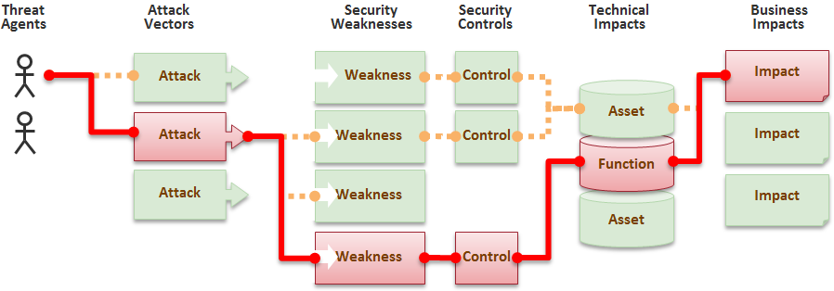
Security Risk

Slide 4
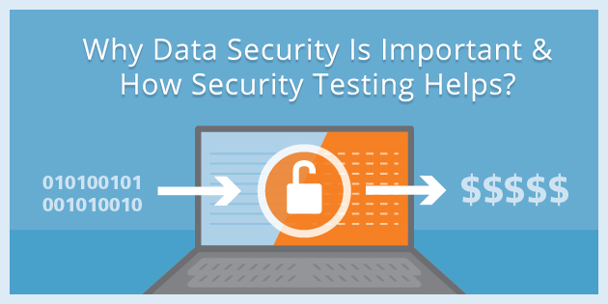
Importance

Slide 5
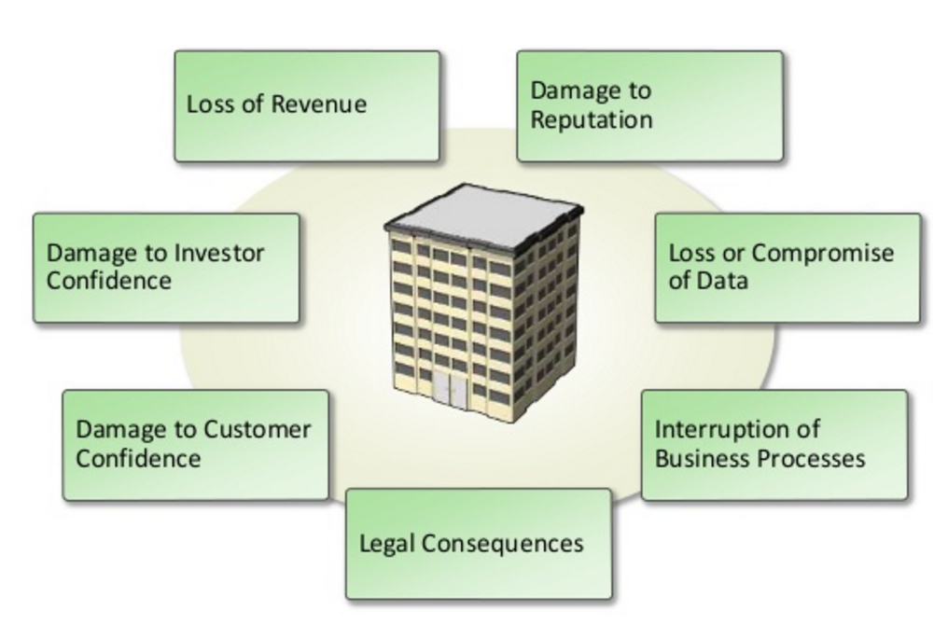
Impact

Slide 6
OWASP
Open Web Application Security Project.
Online community, which creates freely-available articles, methodologies, documentation, tools, and technologies in the field of web application security
Not-for-profit charitable organization.
Focussed on improving the security of software.
All material is available under a FOSS license.
Currently has over 142 active projects.

Slide 7
OWASP Top 10
List the 10 most critical web application security risks.
A powerful awareness document.
Published at regular intervals.
Approximately once in 3 years.
Last published in 2013

Slide 8
OWASP Top 10
Injection.
Broken authentication and session management.
Cross-site scripting (XSS).
Insecure direct object references.
Cross-site request forgery (CSRF).
Sensitive data exposure.
Missing functional level access control.
Security misconfigurations.
Using component with known vulnerabilities.
Unvalidated redirects and forwards.

Slide 9
OWASP ZAP (Zed Attack Proxy)
DEMO

Slide 10
OWASP ZAP (Zed Attack Proxy)
DVWA (An sample application with vulnerabilities)
Take permission before attacking public web applications
Bounty Programmes

Slide 11
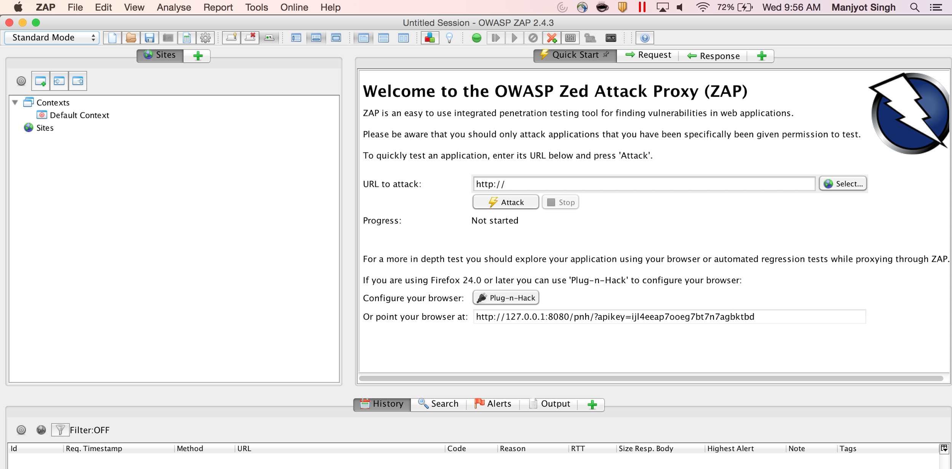
ZAP

Slide 12
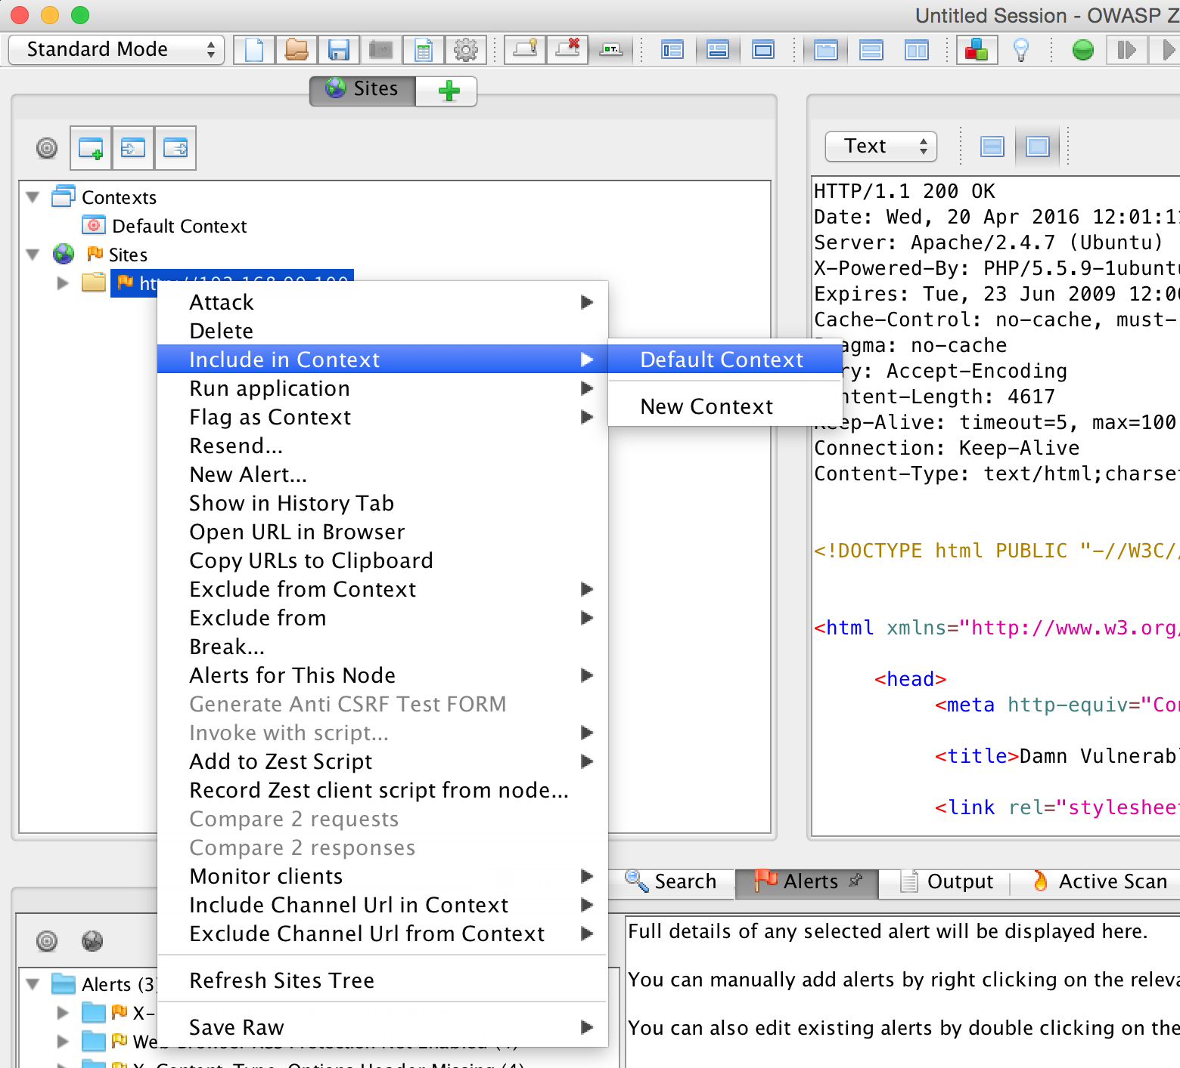
ZAP

Slide 13
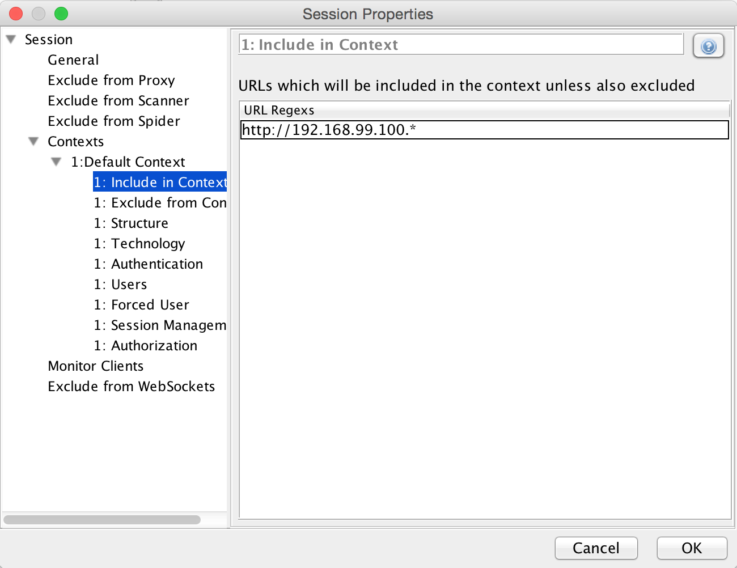
ZAP

Slide 14
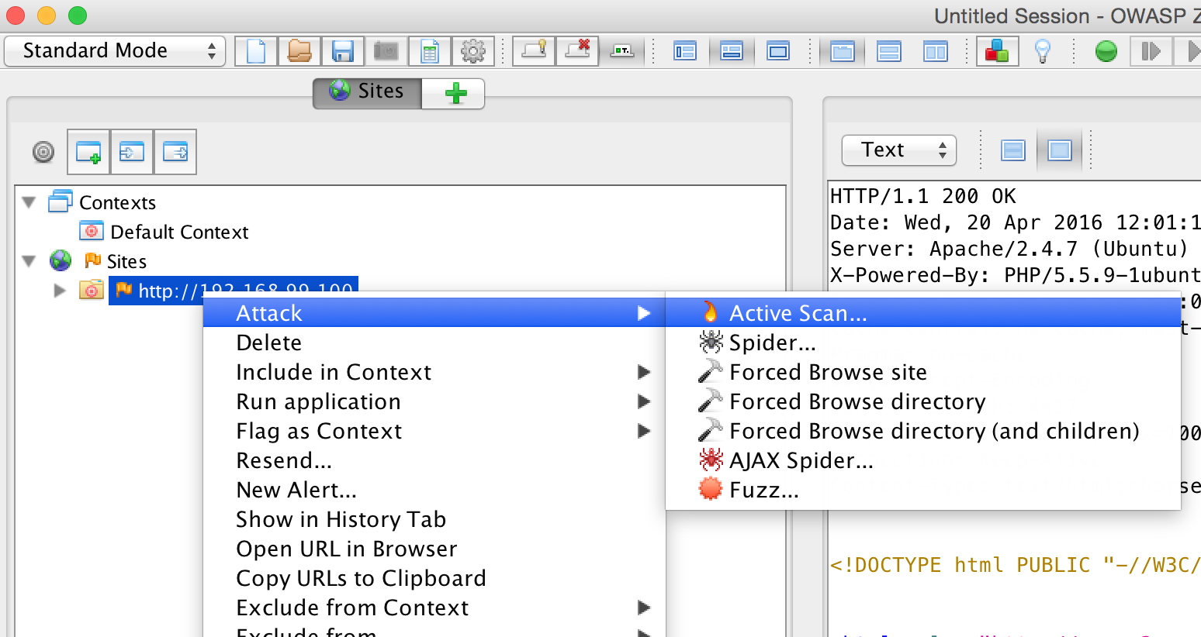
ZAP

Slide 15
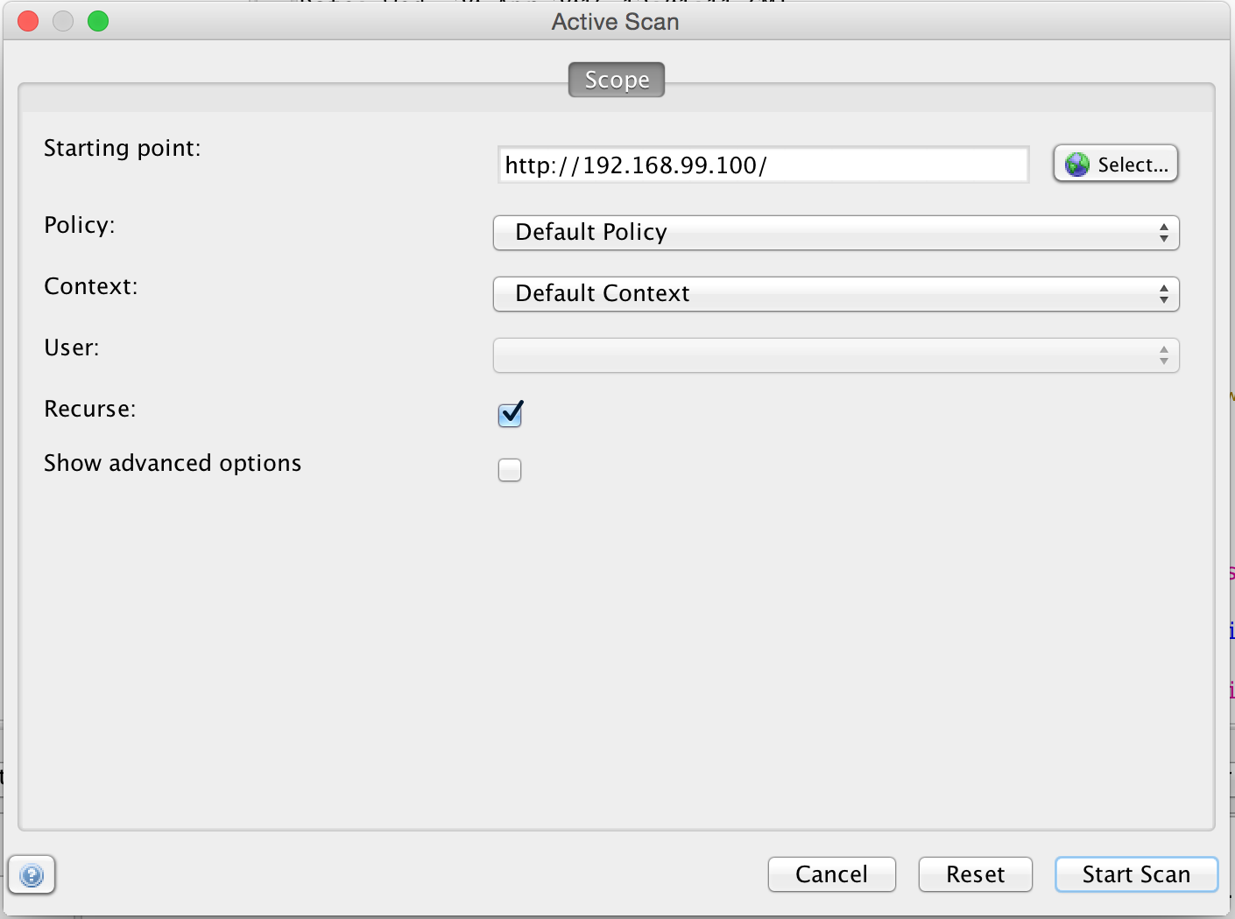
ZAP

Slide 16
OWASP ZAP (Zed Attack Proxy)
1-Injection
Injection flaws, such as SQL, OS, and LDAP injection occur when untrusted data is sent to an interpreter as part of a command or query. The attacker’s hostile data can trick the interpreter into executing unintended commands or accessing data without proper authorization.

Slide 17
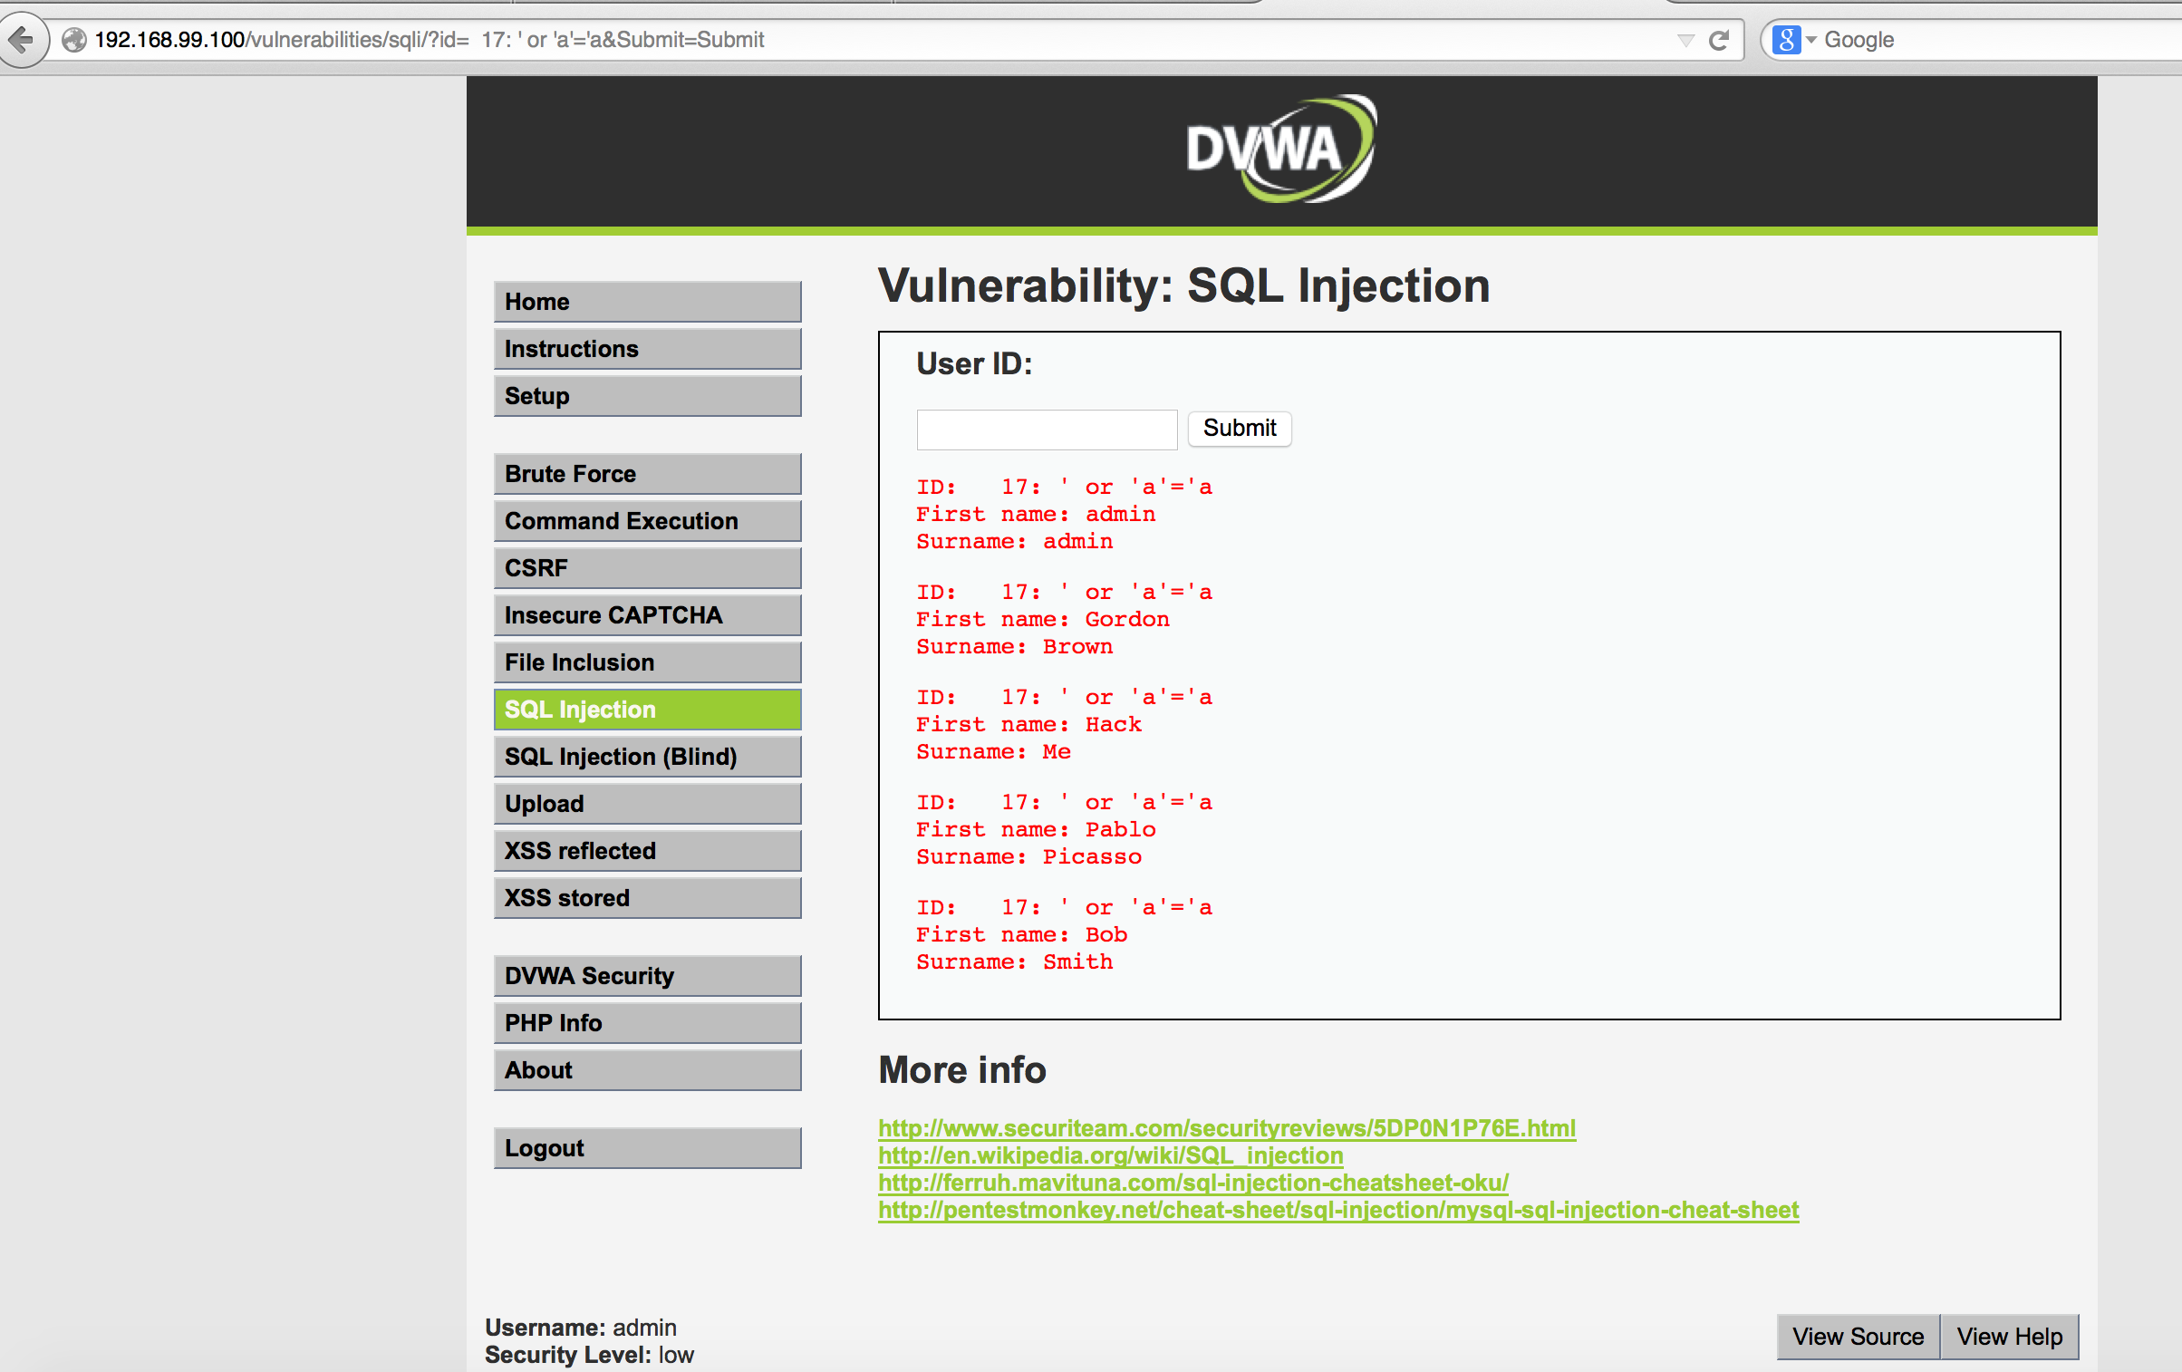
OWASP ZAP (SQL Injection)
http://192.168.99.100/vulnerabilities/sqli/?id=%20%2017:%20%27%20or%20%27a%27=%27a&Submit=Submit

Slide 18
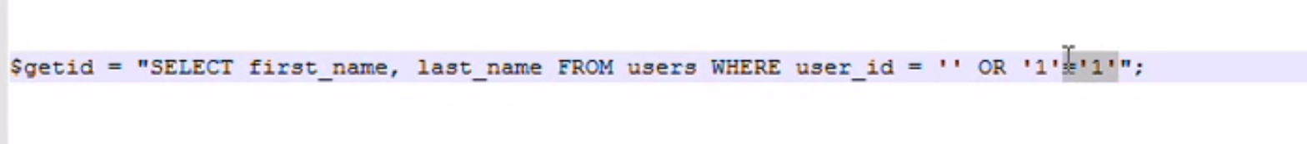
OWASP ZAP (SQL Injection)

Slide 19
SQL Injection - Batched sql statement
SELECT * FROM Users; DROP TABLE Suppliers;

Slide 20
Prevention
Use parameterized queries.
txtName = getRequestString("CustomerName");
txtSQL = "INSERT INTO Customers (CustomerName) Values(@0)";
db.Execute(txtSQL, txtNam);
Notes:
var cmd = new SqlCommand(‘’SELECT * FORM EMPLOYEED WHERE ID=@id”); cmd.AddParameter(“@id”, DbType.Integer, “1 =1”);
declare @id = 20
declare @name = “samaj”
SELECT * FORM EMLOYEE WHERE id = @id OR name= @name

Slide 21
Prevention
declare @0 = ‘ThoughtWorks’; INSERT INTO Customers (CustomerName) Values(@0)";

Slide 22
OWASP ZAP (Zed Attack Proxy)
2- XSS
XSS flaws occur whenever an application takes untrusted data and sends it to a web browser without proper validation or escaping. XSS allows attackers to execute scripts in the victim’s browser which can hijack user sessions, deface web sites, or redirect the user to malicious sites.

Slide 23
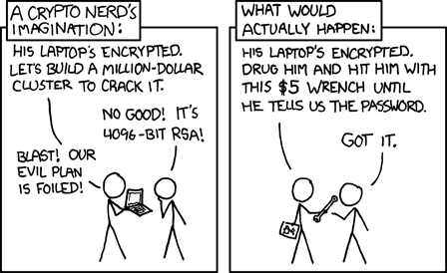
OWASP ZAP (XSS)

Slide 24
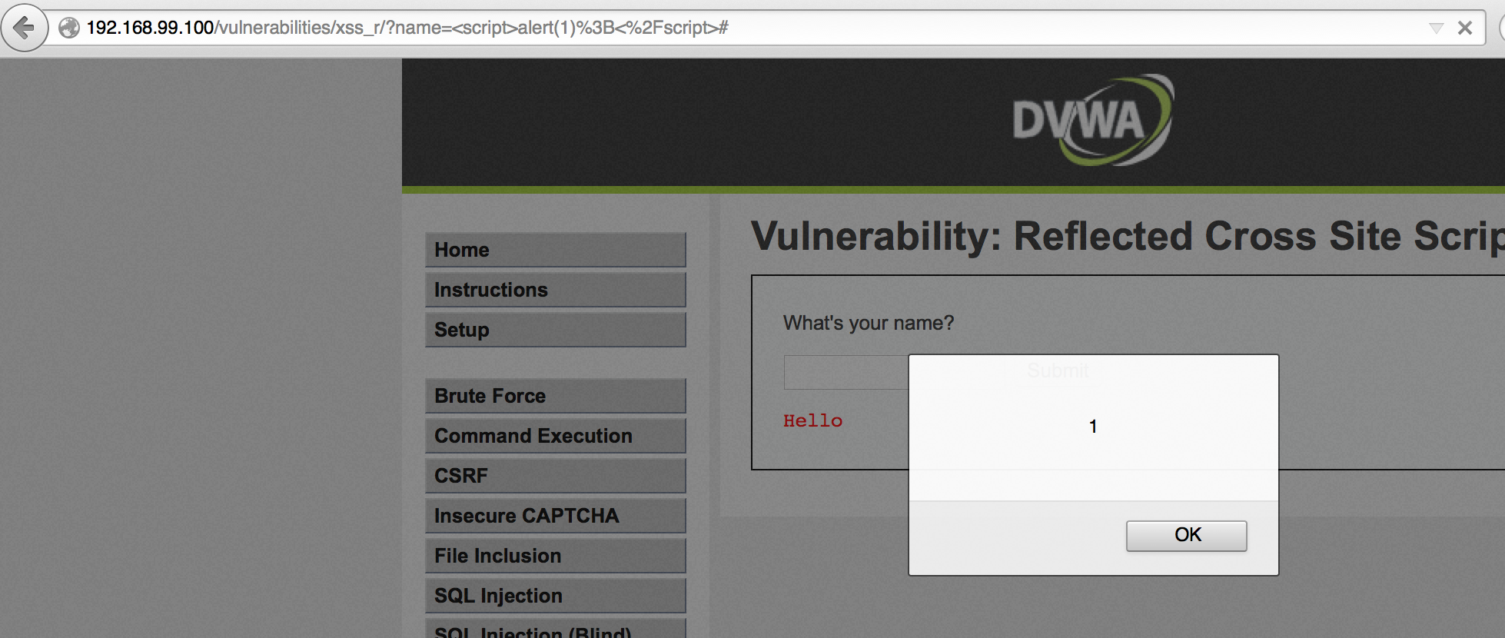
OWASP ZAP (XSS)
What’s your name : <script>alert(1);</script>

Slide 25
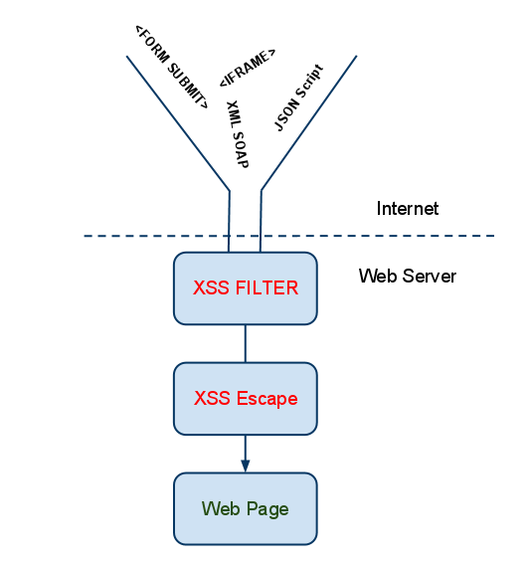
XSS - Prevention

Slide 26
XSS - Prevention
Never insert untrusted data in HTML.
Escape untrusted JSON, JS or HTML before inserting.
Sanitize HTML Markup with a Library Designed for the job.

Slide 27
OWASP ZAP (Zed Attack Proxy)
3-Command execution
Command injection is an attack in which the goal is execution of arbitrary commands on the host operating system via a vulnerable application. Command injection attacks are possible when an application passes unsafe user supplied data (forms, cookies, HTTP headers etc.) to a system shell.

Slide 28
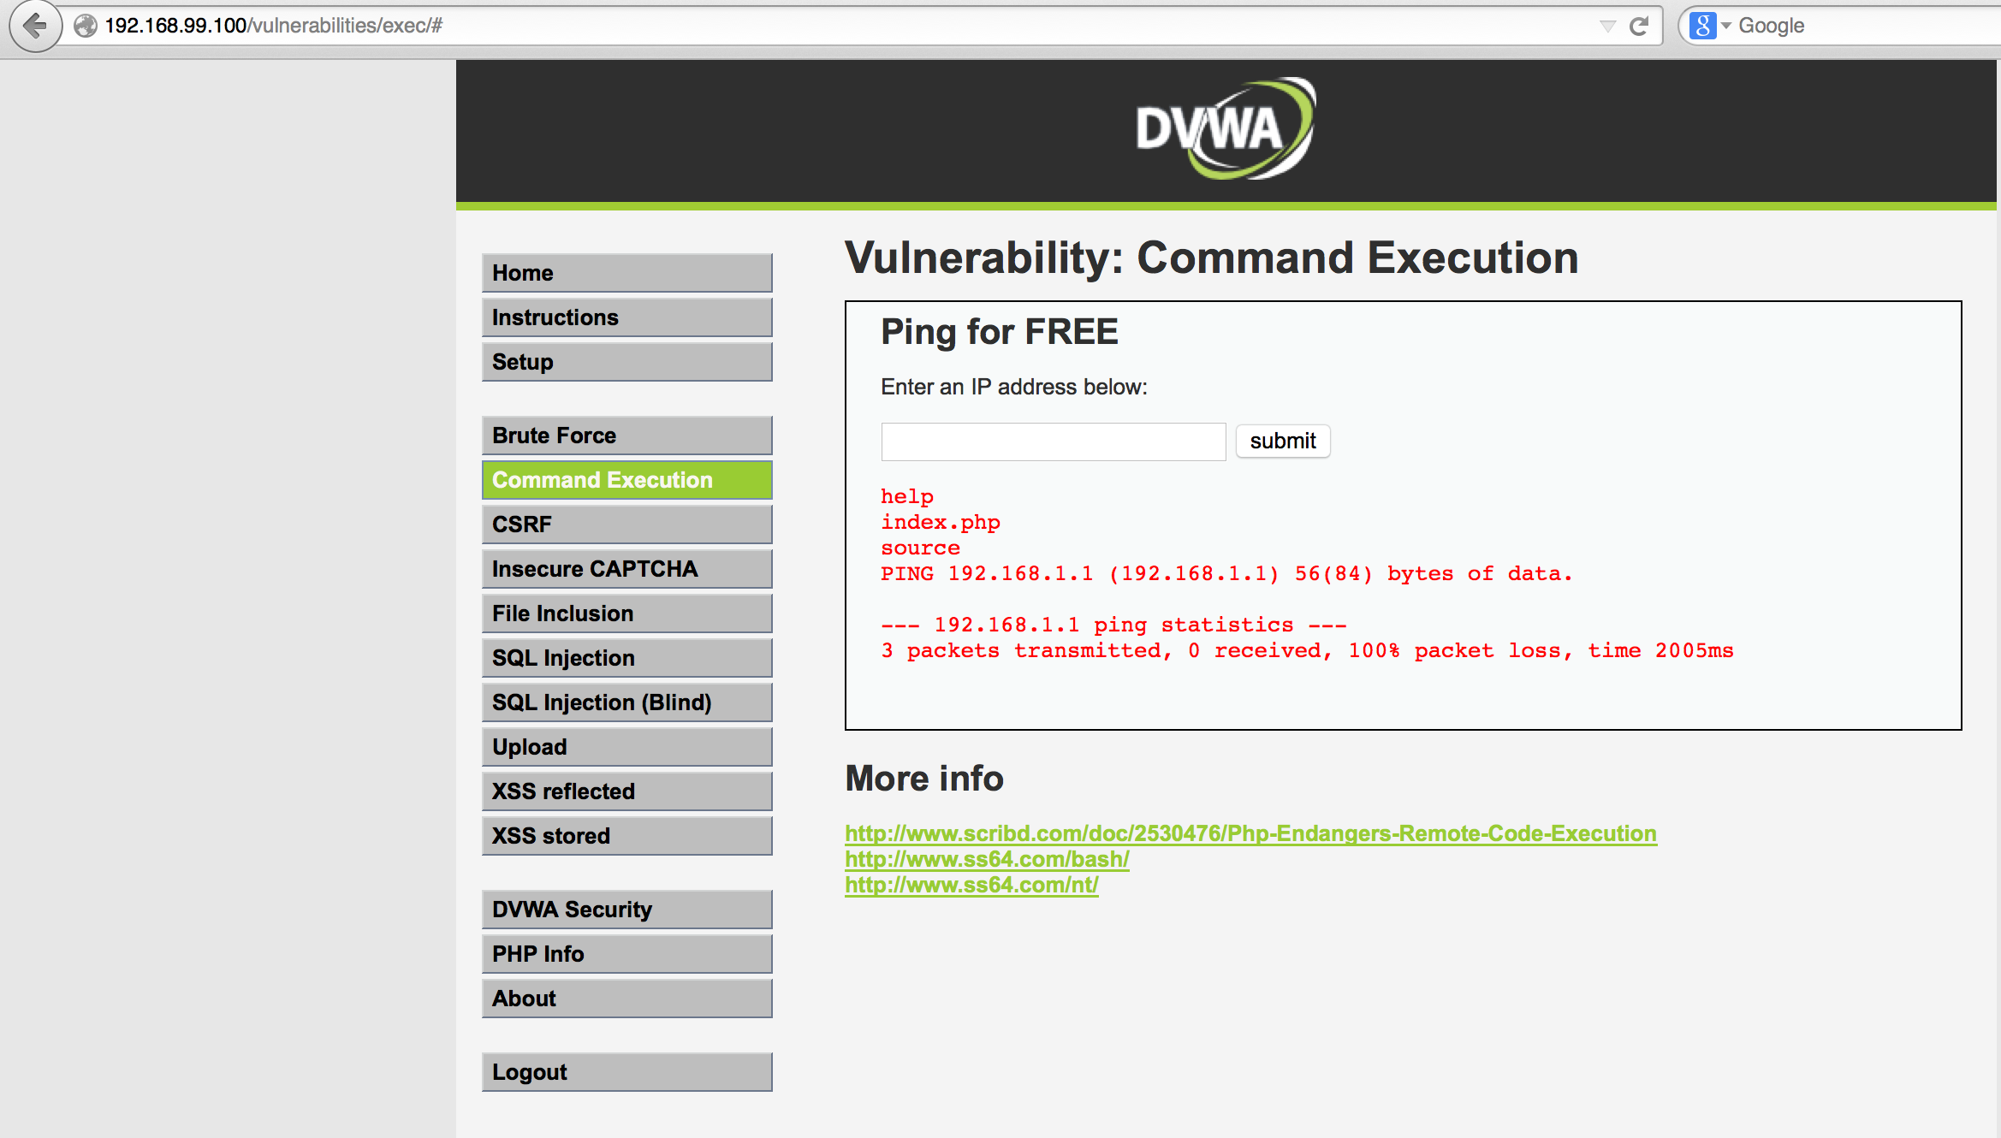
OWASP ZAP (Command Execution)
IP = 192.168.1.1& ls

Slide 29
OWASP ZAP (Command Execution)
int main(char* argc, char** argv) {
char cmd[CMD_MAX] = "/usr/bin/cat ";
strcat(cmd, argv[1]);
system(cmd);
}
Notes:
Pass argument as : ;rm -rf /. Then the call to system() fails to execute cat due to a lack of arguments and then plows on to recursively delete the contents of the root partition

Slide 30
Command Execution - Prevention
The URL and form data needs to be sanitized for invalid characters.
A “blacklist” of characters is an option but -
- it may be difficult to think of all of the characters to validate against. Also there may be some that were not discovered as of yet.
A “white list” containing only allowable characters should be created -
- to validate the user input. Characters that were missed, as well as undiscovered threats, should be eliminated by this list.

Slide 31
OWASP ZAP (Zed Attack Proxy)
4-Brute Force
A brute force attack can manifest itself in many different ways, but primarily consists in an attacker configuring predetermined values, making requests to a server using those values, and then analyzing the response.

Slide 32
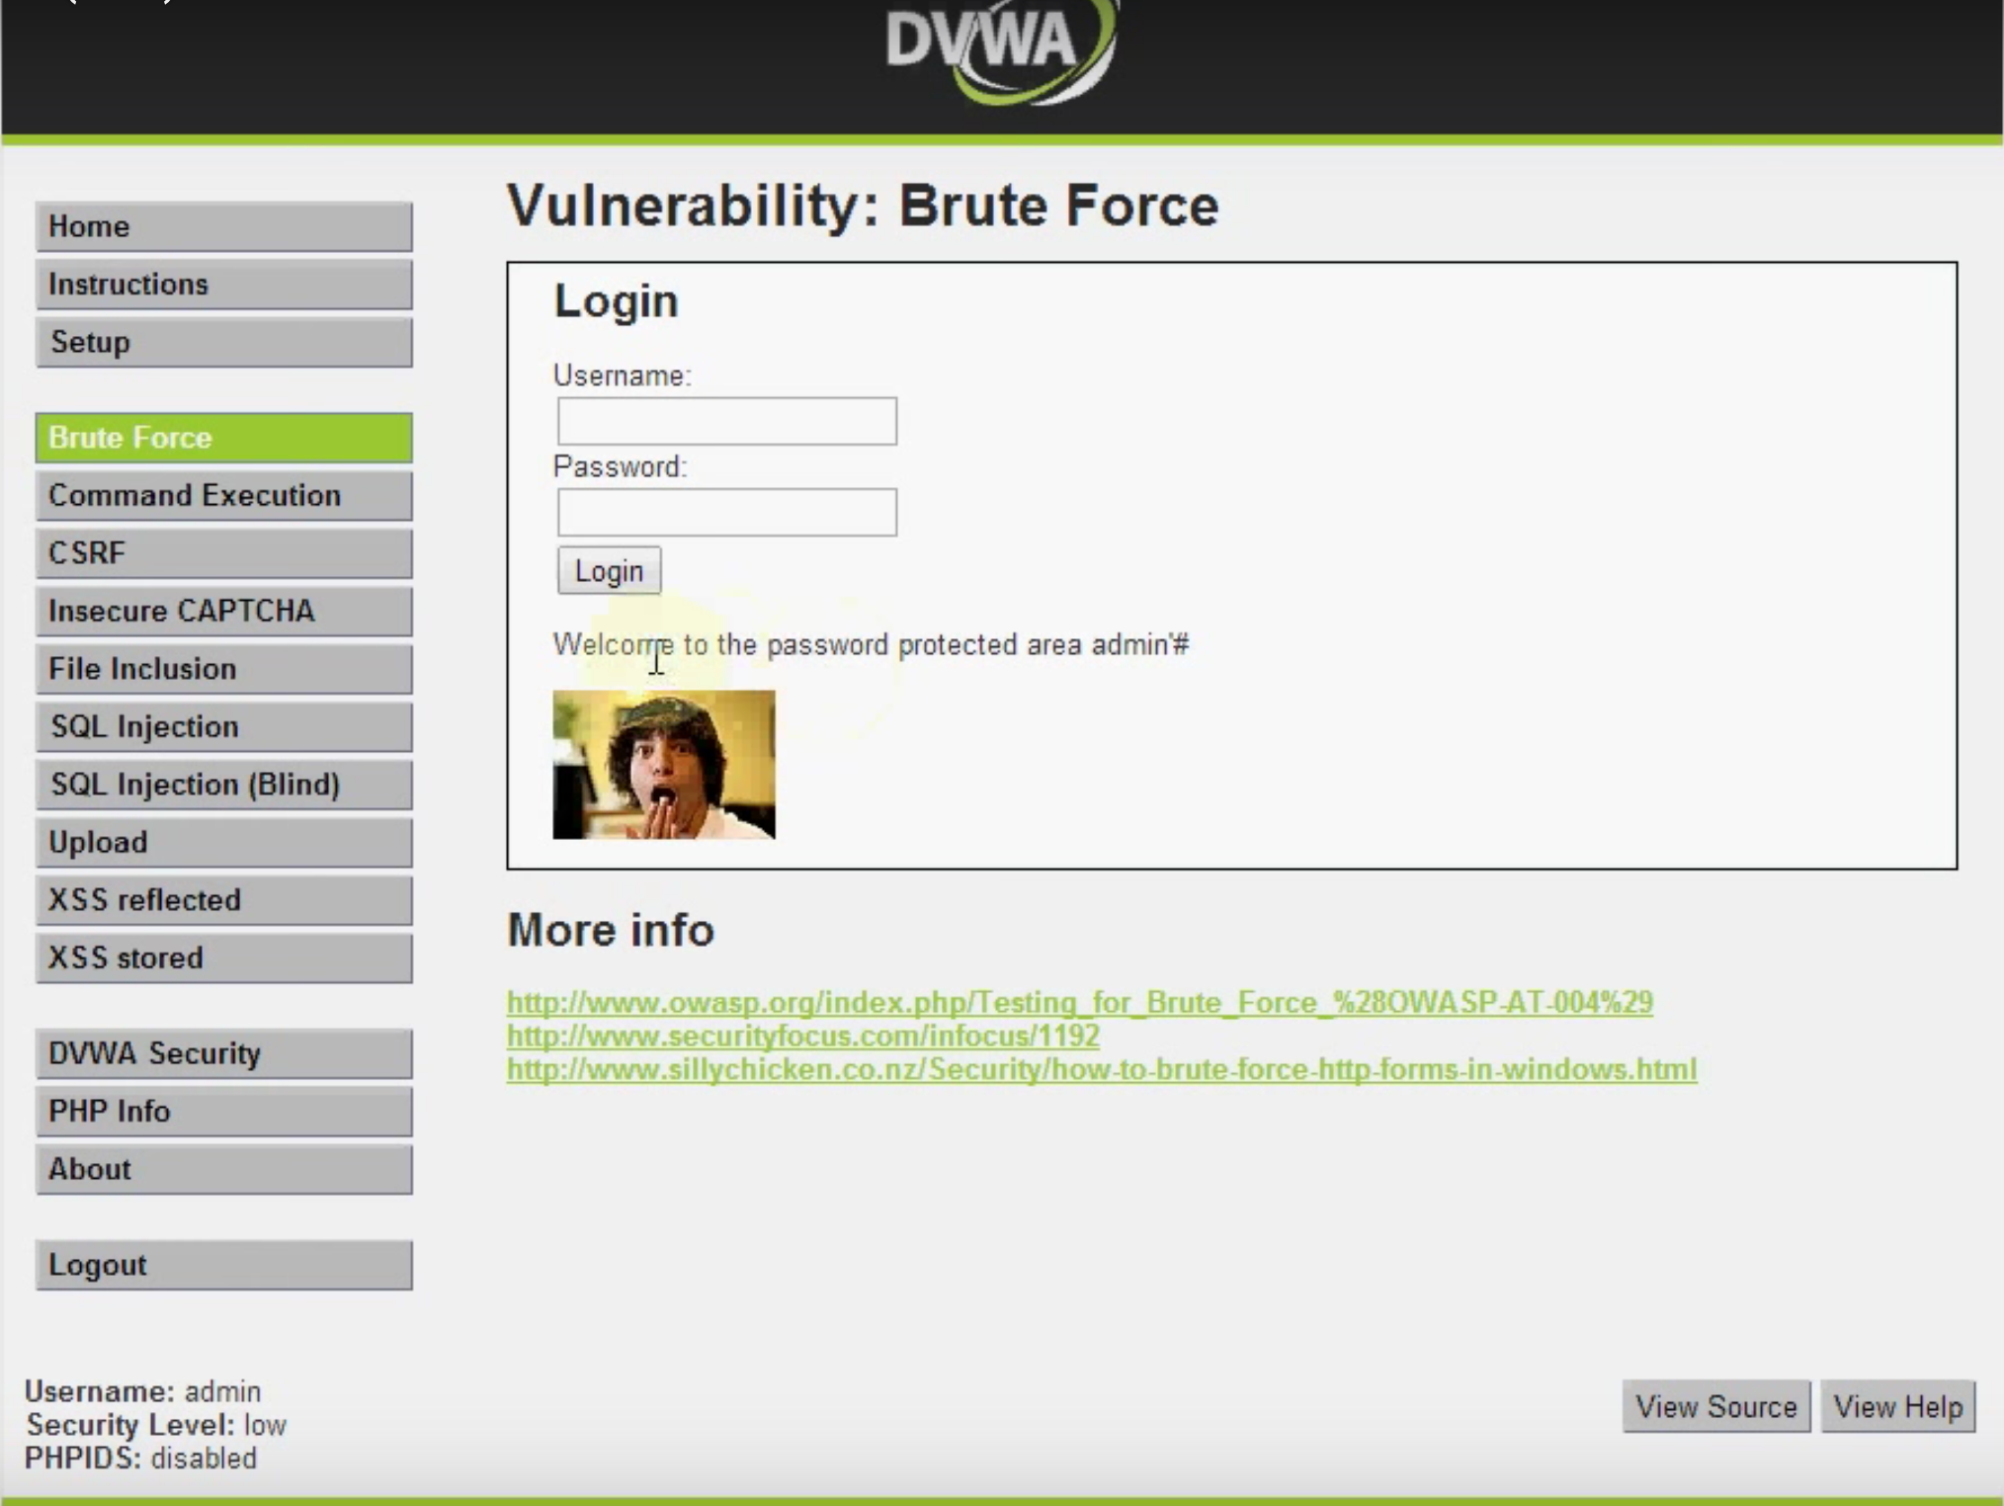
OWASP ZAP(Brute Force)
Username : admin’#

Slide 33
Brute Force - Prevention
The most obvious way to block brute-force attacks is to simply lock out accounts after a defined number of incorrect password attempts.
Another solution is to lock out an IP address with multiple failed logins.
After one or two failed login attempts, you may want to prompt the user not only for the username and password but also to answer a secret question.
Use a CAPTCHA to prevent automated attacks.
Notes:
The problems with account lockouts are:
An attacker can cause a denial of service (DoS) by locking out large numbers of accounts.
Because you cannot lock out an account that does not exist, only valid account names will lock. An attacker could use this fact to harvest usernames from the site, depending on the error responses.
An attacker can cause a diversion by locking out many accounts and flooding the help desk with support calls.
An attacker can continuously lock out the same account, even seconds after an administrator unlocks it, effectively disabling the account.

Slide 34
OWASP ZAP (Zed Attack Proxy)
5-Insecure Direct object references
A direct object reference occurs when a developer exposes a reference to an internal implementation object, such as a file, directory, or database key. Without an access control check or other protection, attackers can manipulate these references to access unauthorized data.

Slide 35
OWASP ZAP (Insecure Direct object references)
http://misc-security.com/file.jsp? file=report.txt
http://misc-security.com/file.jsp? file=**../../../etc/shadow**
Notes:
Malicious user notices following URL:
The attacker could modify the file parameter using a directory traversal attack.

Slide 36
Insecure Direct object references - Prevention
Use indirect reference maps.
Use hash of file name.

Slide 37
OWASP ZAP (Zed Attack Proxy)
6-CSRF
A CSRF attack forces a logged-on victim’s browser to send a forged HTTP request, including the victim’s session cookie and any other automatically included authentication information, to a vulnerable web application. This allows the attacker to force the victim’s browser to generate requests the vulnerable application thinks are legitimate requests from the victim.

Slide 38
OWASP ZAP (CSRF)
http://bank.com/transferFunds? amount=1500&destAccount=12312
Notes:
http://gadgets.ndtv.com/mobiles/news/samsung-find-my-mobile-exploit-allegedly-lets-attackers-remotely-lock-your-phone-613054
Remote lock shock in samsumg mobile

Slide 39
OWASP ZAP (CSRF)
Malicious user tricks the user in opening the image with forged link
<img src=”http://bank.com/transferFunds?amount=1500&destAccount=9999”/>
Notes:
http://gadgets.ndtv.com/mobiles/news/samsung-find-my-mobile-exploit-allegedly-lets-attackers-remotely-lock-your-phone-613054
Remote lock shock in samsumg mobile

Slide 40
CSRF - Prevention
Checking referrer header.
Checking origin header.
Requiring the user to reauthenticate or prove they are a user.
Notes:
http://gadgets.ndtv.com/mobiles/news/samsung-find-my-mobile-exploit-allegedly-lets-attackers-remotely-lock-your-phone-613054
Remote lock shock in samsumg mobile

Slide 41
References
https://en.wikipedia.org/wiki/OWASP
https://www.owasp.org/index.php/Top_10_2013-Top_10
http://www.slideshare.net/vodqanite/introduction-to-security-vulnerabilities
https://docs.google.com/presentation/d/16fn47AZSNxorx-D5DkYjALeEkJ8sGCdZg3MguYrSmrM/edit?ts=56d424e8#slide=id.p

Slide 42

Questions

